Slide 1
HOUSE PRICE PREDICTION
Shainan Agrawal

Slide 2

To move or not to move?
Our client currently works as a software developer for Expedia earning a $140,000 salary in Bellevue, WA. He is evaluating an offer of $145,000 from Microsoft in Alpharetta, GA, for the position of senior software developer.
He currently owns a small single-family home in Bellevue, WA with an estimated worth of $1.2 million. If he moves, he would like to purchase a single-family home within a 10-mile radius of the new work location in Alpharetta, GA as he does not like long commutes.
He has three school-age children, so he would like to live in a family-friendly neighborhood with low crime rates.

Slide 3

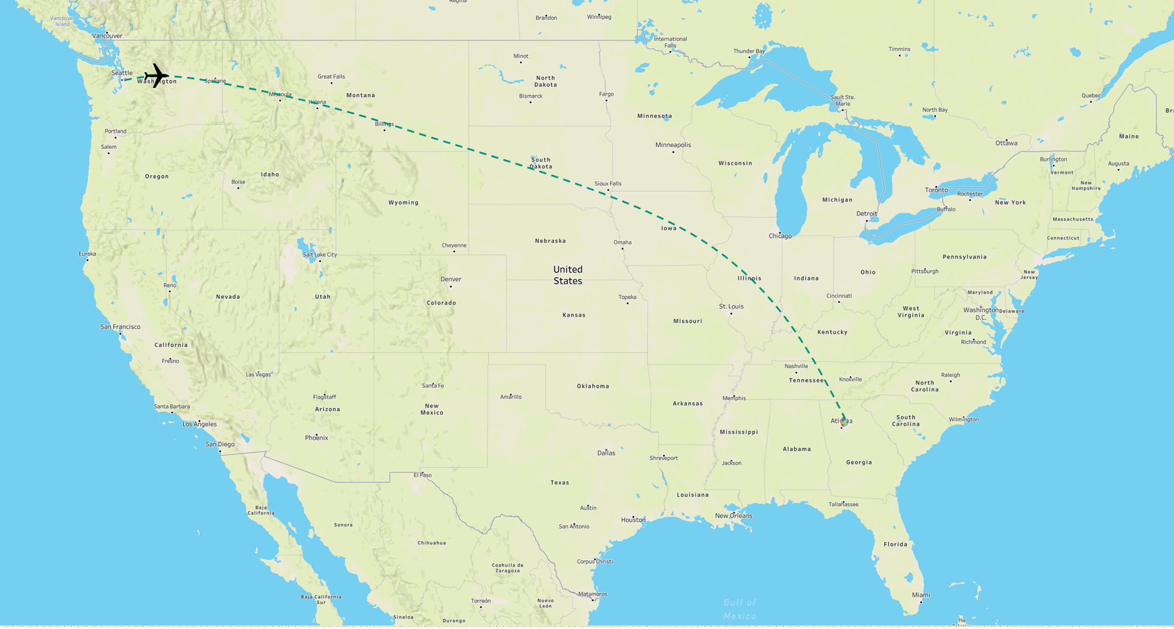

What Next ?
To help with the decision analysis, we did the following:
Selected 5 zip codes based on the commute distance and home purchase price and divided analytics into 3 parts:
Descriptive - Evaluate the home price trends within a 10-mile radius of Alpharetta, GA
Predictive - Forecast the home prices of the selected neighborhoods and identify the growth in property prices.
Prescriptive - Make an optimal decision whether to move or not based on:
- Commute Time
- Growth of housing property
- Salary
- School expenditure per child

Slide 4


Our Dataset
Zillow launched in 2006 and is the leading real estate database in US
Holds data on over 110 million homes for sale, dating all the way back to 1996
The Zillow Home Value Index is the company’s flagship measure of home value
Estimates within 10% of sales price more than 95%
We gathered zip code data for median home prices for the greater Atlanta area
Combined this data along with crime rate, tax, utility rates during analysis

Slide 5
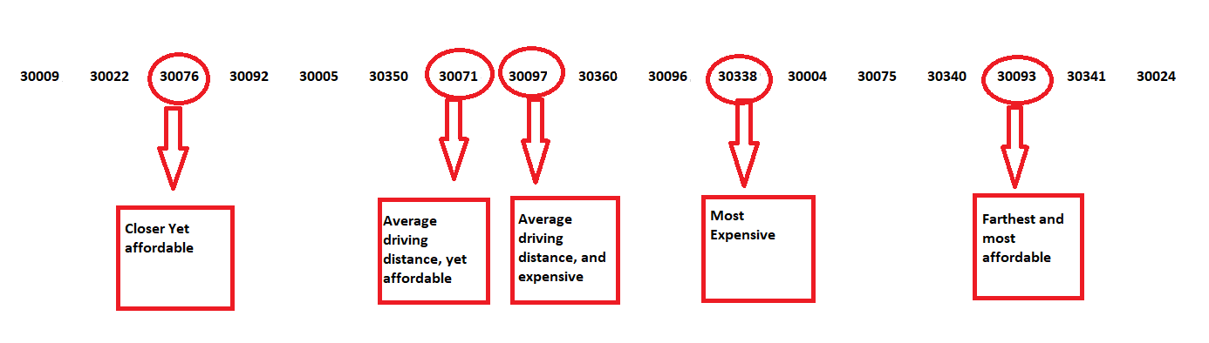
Analysis and Data collection
The initial dataset consisted of 17 zip codes, of which we selected 5 based on the following factors :
Distance from work location
Median Home Price

Slide 6
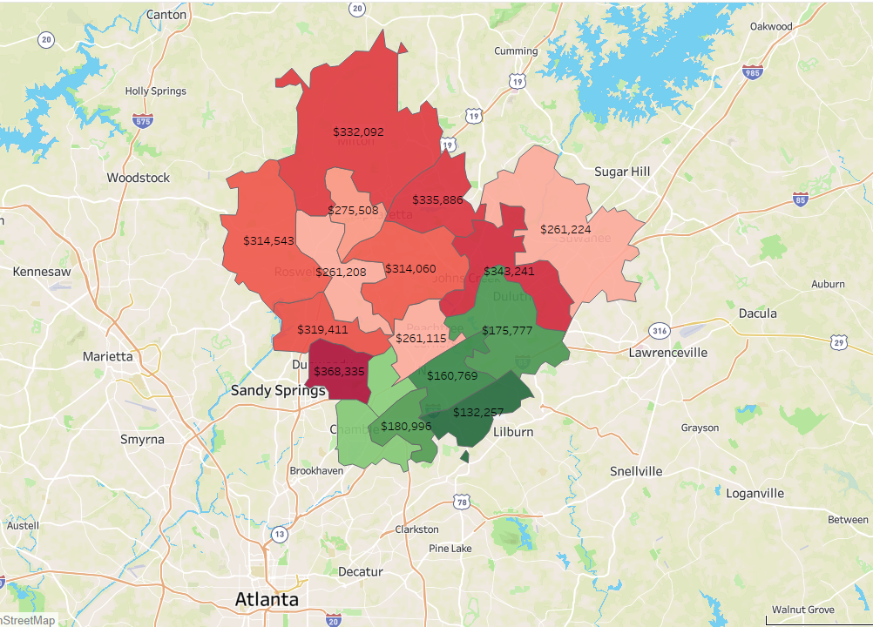
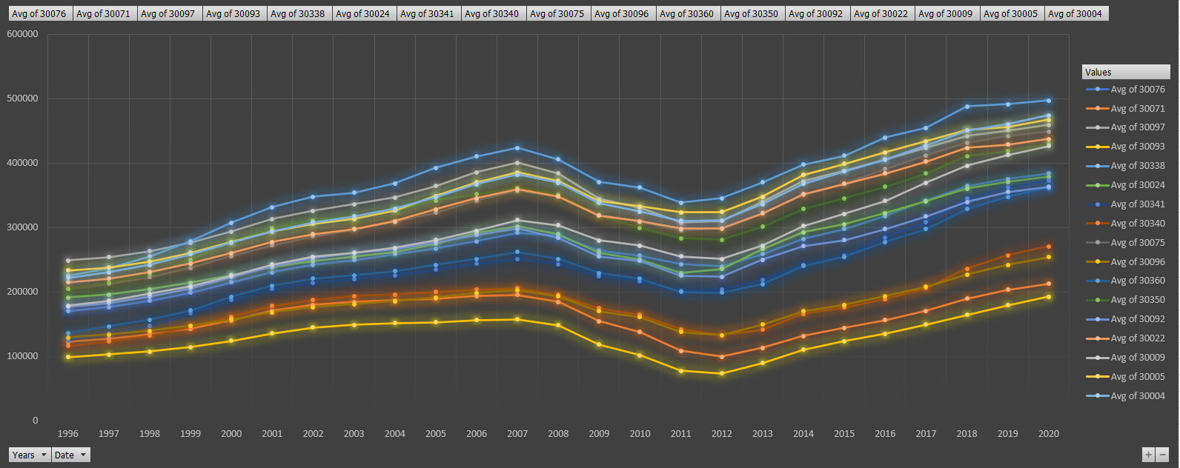
Descriptive Analytics
For observing trends of the housing prices of various zip codes which are located within the 10-mile radius of our client’s new location , the graph shows the distribution of median price of single-family homes for the zip codes in Alpharetta, GA. From dark green to dark red, indicating most affordable to most expensive zip codes.
The line graph shows the distribution of median selling price, by year. Where overall we see a similar the trend, of prices showing a decline between the years 2008 - 2011 and resurrecting into an upward trend from year 2012 onwards.

Slide 7
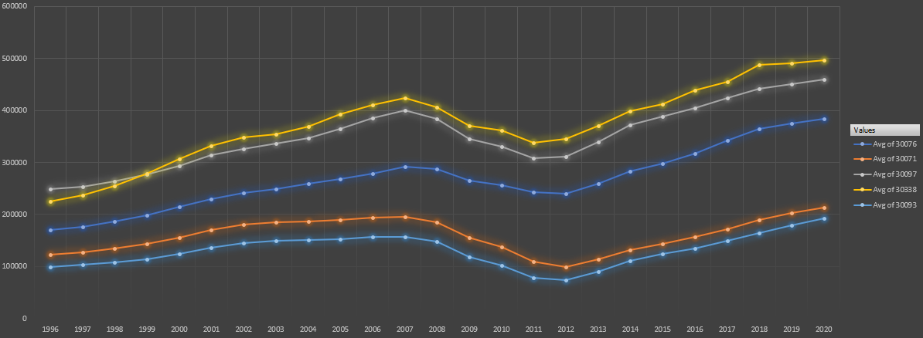
Descriptive Analytics
Zip codes show a similar trend → linear growth until 2007, drop in 2008, and again a positive linear growth after. Graph also shows minor nuances, indicating different areas having different growth. Zip code 30338 is the most expensive and zip code 30093 is the most affordable.
Though initially in the late nineties, the zip code 30097 was the area with most expensive homes, zip code 30338, surpassed its growth from 2000 onwards. The zip codes 30071 and 30093 show very similar growth patterns, however, the distance between them indicates that the growth rate was different for each time period.

Slide 8
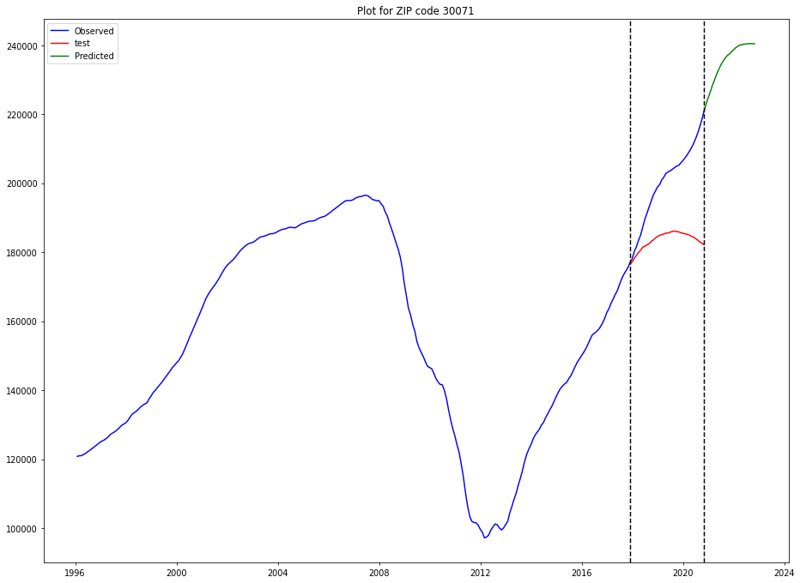
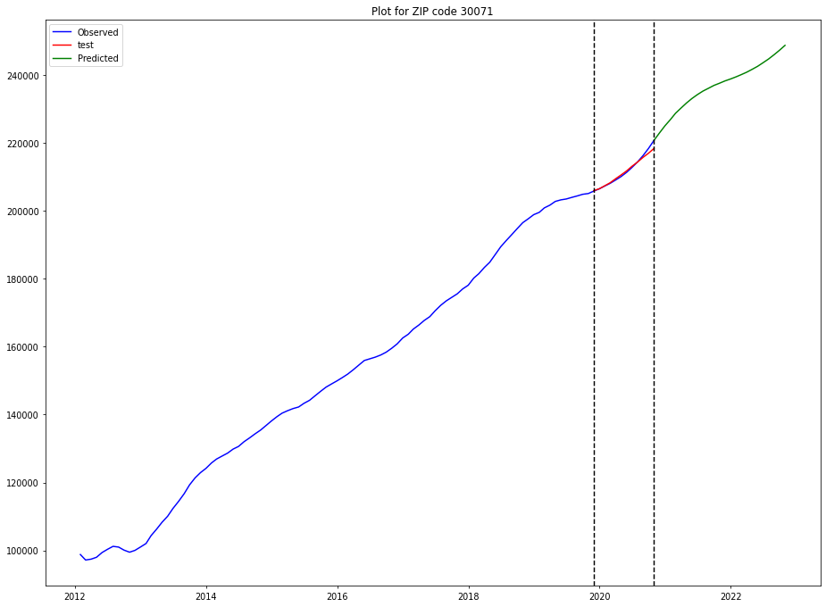
Predictive Analytics
Predictive modelling using time series was performed for the selected zip codes based on our client’s preferences. For 30071:
For data from 1996, the MAPE value was 18.76%.
The model predicted test values indicative of cyclic trends, indicating a potential drop in prices, as in 2008.
Then, the time series of predictive modelling was performed on the data from 2012, a time when the housing market started to see recovery, post recession.
In this case, the MAPE value was more accurate with 4.6%, test values are indicative of a linear growth , that matches the observed values, for a prediction of 24 months.

Slide 9
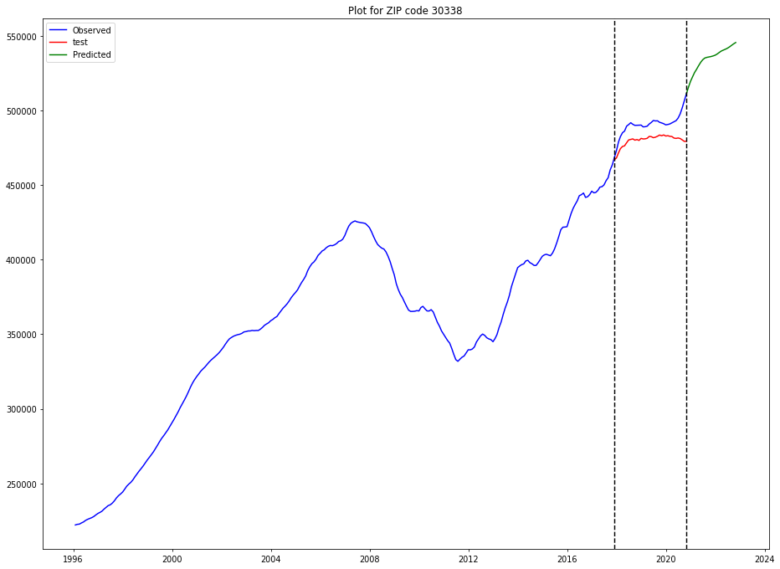
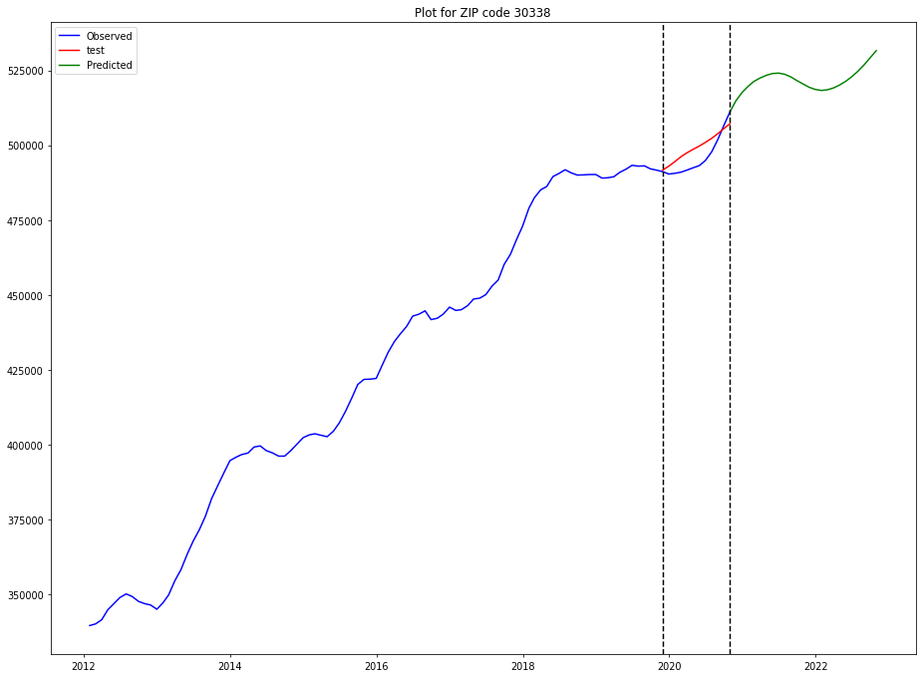
Predictive Analytics
Now, on looking into the time series model for zip code 30338, we can say that it had a rough recovery as compared to 30071, with many highs and lows.
The MAPE value for the dataset from year 1996 was 11.45%
And similar to other model, the test values shows an indicative drop in prices.
The time series on the data from 2012, displayed a combination of seasonal trend combined with linear trend can be seen.
This is indicative that the market had an upward growth, it also shows signs of minor drops in between the growth.
Notes:
While the post-2012 models for each zip code were better overall than the models using data beginning in 1996, each zip code has a different MAPE value, which is an indication of how different areas of the country experienced the housing market recovery differently.

Slide 10
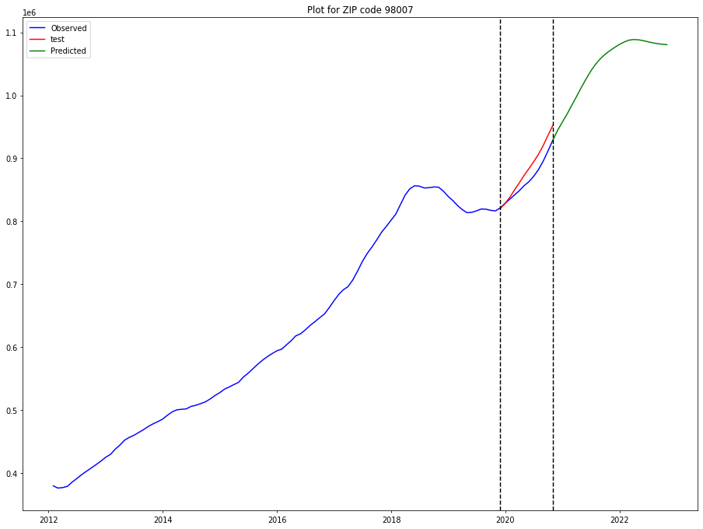
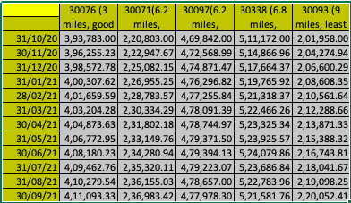
Predictive Analytics
We also considered doing a 12- month predictive model for our client’s current home in Bellevue, WA in zip code 98007 .
The housing market for zip code experienced a drop around mid-2019 before recovering through 2020. With a MAPE value of 7.75%, the model is a fairly good predictive indicator of home value over the next year.

Slide 11
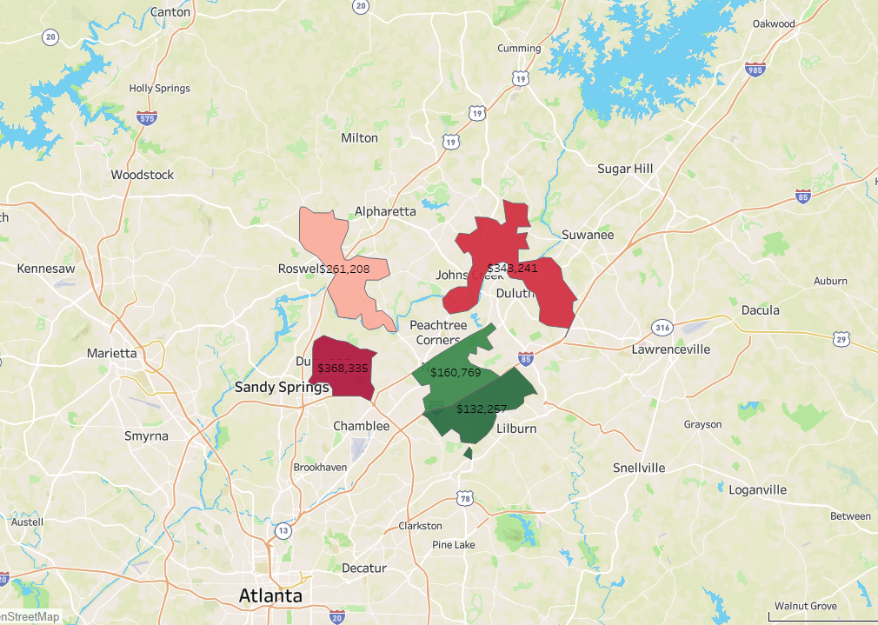
Prescriptive Analytics
5 selected zip codes for final evaluation
Darker red = more expensive
North side in graph
Darker green = more affordable
South side in graph

Slide 12
Prescriptive Analytics
Binary Optimization Problem
Binary linear minimization model to determine which zip code to live in strictly on the cost of living
Used binary optimization rather than standard integer optimization to make a decision on where to live
Takes into account property tax, fuel costs, and utility costs to decrease unnecessary expenses
Uses Excel model to form a minimization model for living costs with defined constraints

Slide 13
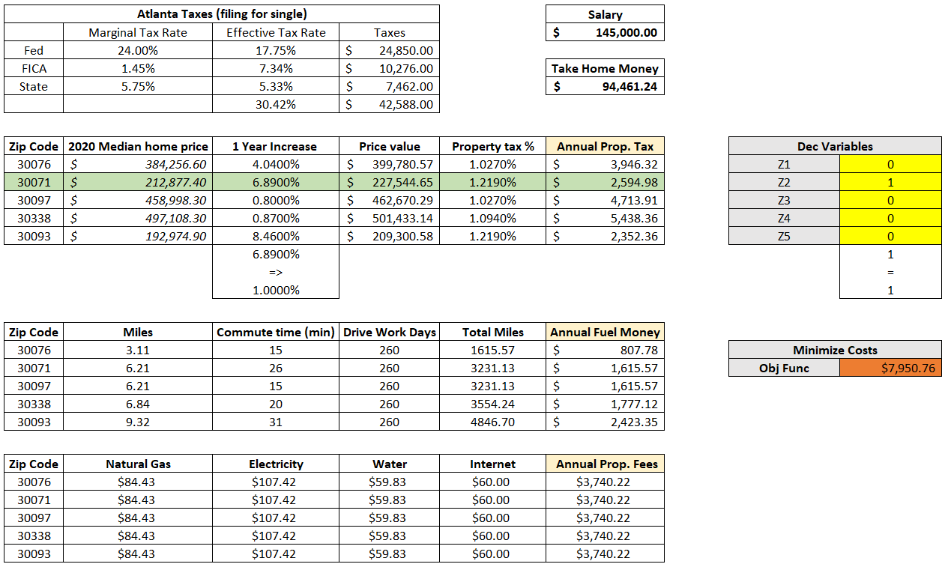
Prescriptive Analytics
Mathematical formulation in Appendix A

Slide 14
Prescriptive Analytics
Utility Function Problem
Utility theory takes into account the decision-maker’s tolerance for risk
Criteria: salary, commute time, projected home value increase, violent crime, property crime, moving costs, and school zone
Client has three school-age children
Prefers shorter commute distances
Client considers each additional hour of commute to be worth half an hour’s wage

Slide 15
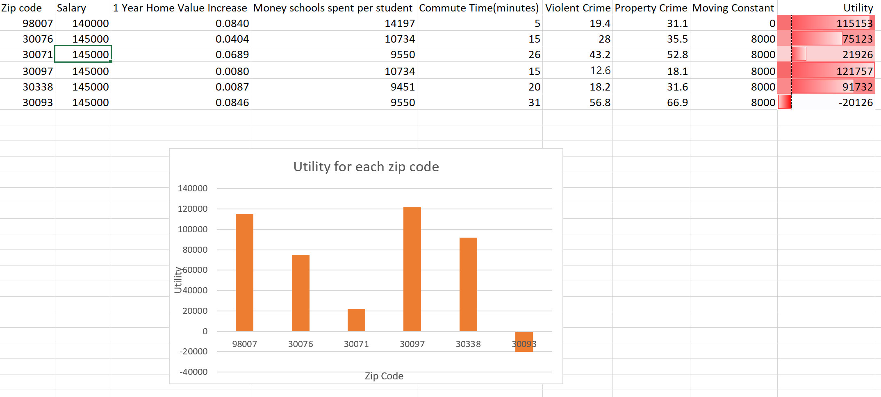
Prescriptive Analytics
Mathematical formulation in Appendix B

Slide 16
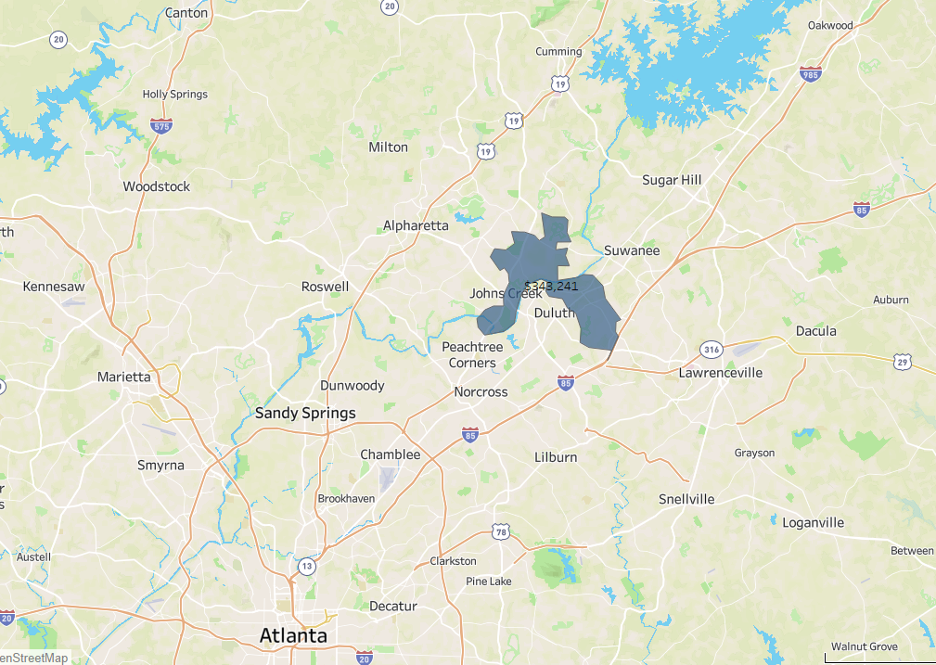
Prescriptive Analytics
Initial 17 Zip Codes
Final Zip Code: 30097

Slide 17
Conclusion
Binary linear optimization model gives an inexpensive option, not factoring into crime rates, commute times, or school spending --> Zip Code: 30071
The utility model to present a more personalized recommendation to the client with regard for his needs --> Zip Code: 30097
Criteria such as working environment, opportunities for advancement, or city lifestyle affect decision making
Zillow provides only median home sales data, not individual sales prices
Data is a powerful tool for making a decision, but is only one piece of the puzzle for making life decisions

Slide 18
QUESTIONS?
QUESTIONS?

Slide 19
Appendix A: Binary Mathematical Formulation
Binary Linear Minimization Model:
Setup
Let Z be a binary variable representing 5 selected zip codes
Z1 = 1 --> zip code chosen to live in
Z1 = 0 --> otherwise
Let P be price of property tax for 5 selected zip codes
Let F be price of fuel costs for 5 selected zip codes
Let U be price of utility costs for 5 selected zip codes
Minimize
(Z1*P1 + Z2*P2 + Z3*P3 + Z4*P4 + Z5*P5) +
(Z1*F1 + Z2*F2 + Z3*F3 + Z4*F4 + Z5*F5) +
(Z1*U1 + Z2*U2 + Z3*U3 + Z4*U4 + Z5*U5)
Subject To
(Z1 + Z2 + Z3 + Z4 + Z5) = 1
1 year property increase > 1.00%
All variables are nonnegative

Slide 20
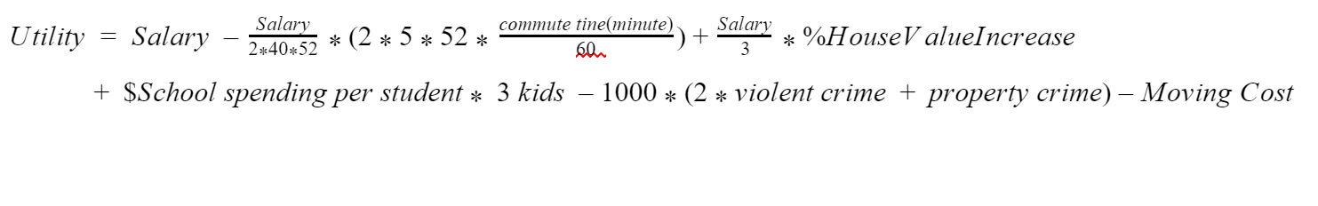
Appendix B: Utility Mathematical Formulation
Utility Model:

